Slide 1
PersonAl Branding Telling your story
Julie Carroll, Outcomes Lead
General Assembly

Slide 2
PERSONAL BRANDING
LEARNING OBJECTIVES

Slide 3
LEARNING OBJECTIVEs
Each student will develop a personal branding statement that highlights his unique skills and qualities.

Slide 4



PERSONAL BRANDING
PERSONAL BRANDING
Notes:
What is it and why is this important?
Learning to SELL YOURSELF.

Slide 5

PERSONAL BRANDING
Strong Personal BrandIng

Slide 6
PERSONAL BRANDING
WHEN YOU’LL USE IT
Personal Branding Statement
A 30-second elevator pitch that you can tell someone when they ask you “So, tell me about yourself.”
In writing: Summary statement on your resume.
Your Story
An expanded version of your statement that you would share at networking events and job interviews.
In writing: Summary statement on your LinkedIn profile + other accounts.

Slide 7

PERSONAL BRANDING
Facts tell, stories sell.
The human brain is designed to remember stories with emotional impact.

Slide 8
PERSONAL BRANDING
Crafting your Story

Slide 9
PERSONAL BRANDING
SELF-REFLECTION: You, the professional
Core Values → What are your fundamental beliefs and guiding principles?
Passions → What motivates and intrigues you?
Vision → What does your ideal career look like?
Strengths → What are your best characteristics and skills?
Uniqueness → What sets you apart?

Slide 10
PERSONAL BRANDING
DEVELOPING YOUR STORY
Take a few moments to answer these questions. Be yourself!
Who are you?→ What basic facts should people know? How do others describe you?
What makes you awesome?→ What are your unique strengths? What value do you bring to teams and companies?
Where are you going?→ What will you do next? How will you make an impact? #focusonwhereyouaregoingnotwhereyou’vebeen

Slide 11
PERSONAL BRANDING
EXAMPLE BRANDING STATEMENT: SPOKEN
I’m a UX Designer with a background in childhood education, so I like designing apps for children and teachers. I’ve spent the last four years in public schools empathizing with teachers and children who struggle with technology. I believe that having empathy and listening to others is my biggest strength, which is why I’m so enthusiastic about user experience design! This is because I like working with others to come up with simple, beautiful, and creative solutions specifically for the user. Now I’m looking for the best way to position myself to work for a mission-driven company where I can really make a strong impact on my community through effective design.

Slide 12
PERSONAL BRANDING
EXAMPLE BRANDING STATEMENT: WRITING
I was renovating houses in Seattle when a friend sent me a link to a online course in Python, along with a simple message: "I think you'd be good at this." Three months, one Harvard summer class and one General Assembly immersive program later, I think it's safe to say that my friend was right. Programming is my long-undiscovered passion, and I have taken to writing code like a fish to water. I am an efficient, resourceful problem solver. I love developing new systems. I love to collaborate, helping to make the most of diverse talents within a group through quiet leadership. I make serious work joyful through tactful application of humor and frequent celebration of small victories. In every aspect of my life, I am devoted to leaving things better than I found them. In addition to my recent, intensive training as a full-stack web developer, I have worked as a teacher, a researcher, a production carpenter, and a project manager. This broad base of experience proves my adaptability, an essential skill in the fast-changing world of development.

Slide 13
ACTIVITY:
DEVELOPING YOUR NETWORK
GIVE YOUR ELEVATOR PITCH

Slide 14

PERSONAL BRANDING
Practice, Practice, Practice
Let’s say you’re at a networking event. Introduce yourself to someone. Work off of your Personal Branding Statement.
Time for elevator pitches!

Slide 15
PERSONAL BRANDING
ASSIGNMENTS – DUE IN GOOGLE DOC
Craft a compelling Personal Branding Statement – submit this a day before Outcomes
Review 2 colleagues’ PBSs – due by next Outcomes

Slide 16
Digital Presence Selling your story
Julie Carroll, Outcomes Lead
General Assembly

Slide 17

DIGITAL PRESENCE
GitHub (WDI ONLY)

Slide 18
DIGITAL PRESENCE - GITHUB
GITHUB IS YOUR CODE PORTFOLIO
Sometimes Github is all you need to prove you are a strong developer.
Keep it clean and neat, and always be adding to it!
At the end of the course, have your colleagues star your top repositories.

Slide 19
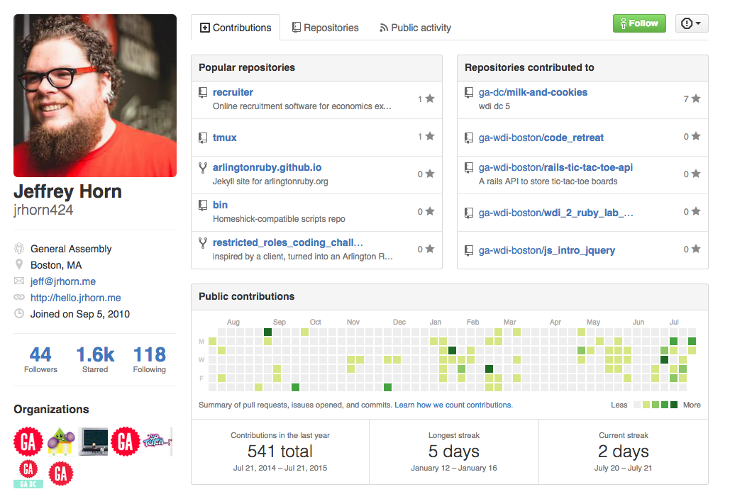
DIGITAL PRESENCE - GITHUB

Slide 20

DIGITAL PRESENCE
LinkedIn

Slide 21
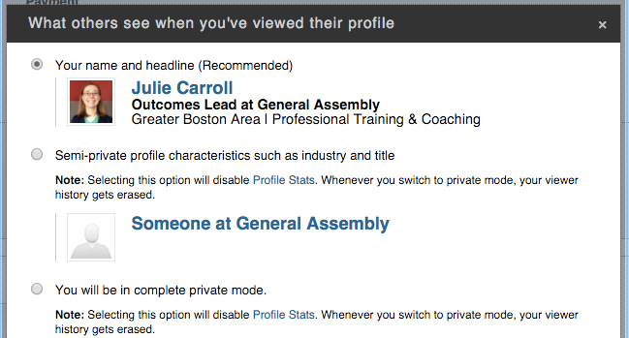
TURN OFF ACTIVITY BROADCASTS (Do NOW)
LINKEDIN BASICS
“Sharing profile edits”
Pros and cons?
“Profile viewing options” aka LinkedIn stalking.
Pros and cons?
ACCOUNT & SETTINGS
PRIVACY & SETTINGS
PRIVACY CONTROLS

Slide 22
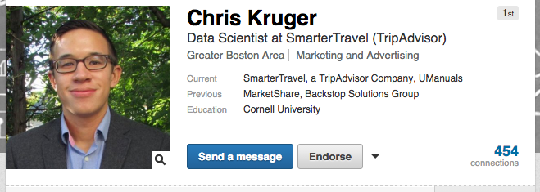
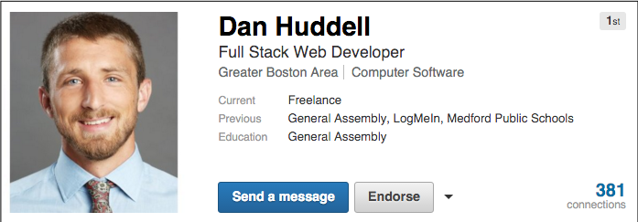
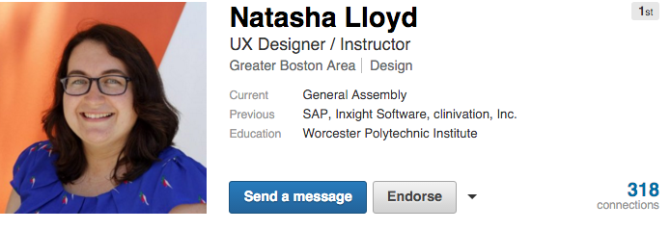
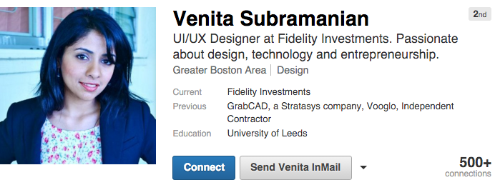
HeadShot + HeadLINE
LINKEDIN BASICS

Slide 23
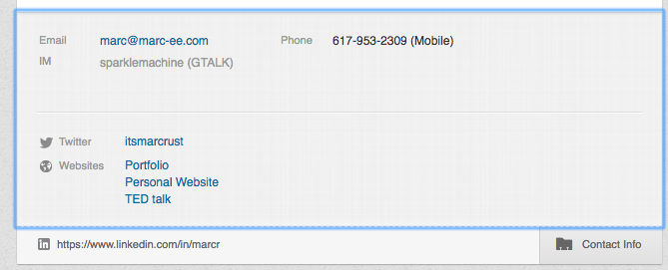
Contact information
LINKEDIN BASICS
List your email address
Include links here (and elsewhere on Profile)
ADD PORTFOLIO LINK

Slide 24
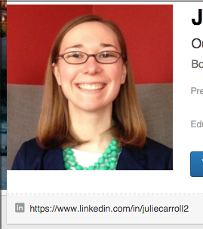
Customize your url
LINKEDIN EXTRAS
Click ‘Edit Profile’ under Profile tab
Under your headshot, there is a URL and a gearwheel next to it
On the right side, Under ‘Your Public Profile URL’; click the pencil to edit your URL

Slide 25
Summary
LINKEDIN SUMMARY
Based off your Personal Branding Statement!
Draw from your Personal Branding Statement: Who are you? What makes you awesome? Where are you going?
VERY important part of your profile – recruiters read this first.
Drive traffic to your portfolio.
Write in first person
Show your personality
Writing the perfect LinkedIn Summary

Slide 26
EXAMPLES
LINKEDIN SUMMARY
3 Amazing LinkedIn Summaries
How to Write a LinkedIn Summary
Put a Human Voice in your LinkedIn Summary

Slide 27
EXPERIENCE
LINKEDIN – the important stuff
NOT a resume! Keep it skimmable.
Full time work, internships, part time jobs, etc.
Keep it relevant – remove old stuff.
Use bullet points or short sentences
Highlight accomplishments, not just responsibilities.
Ask for and provide recommendations from supervisors.
Optimize for searchability using keywords

Slide 28

Where to put general assembly?
LINKEDIN – the important stuff
&
EXPERIENCE
EDUCATION

Slide 29
GA – ADD A CERTIFICATE
LINKEDIN – the important stuff
Use these links to automatically add any FT or PT course at GA.
Digital Marketing Circuit
HTML, CSS, and Web Design Circuit
Data Analysis Circuit
User Experience Circuit
JavaScript Circuit
WDI Remote
Front End Web Development Part-Time
Data Analytics Part-Time
Data Science Part Time
Digital Marketing Part-Time
JavaScript Development Part-Time
Product Management Part-Time
User Experience Design Part-Time
Visual Design Part-Time
Android Development Immersive
Data Science Immersive
iOS Development Immersive
User Experience Immersive
Web Development Immersive

Slide 30
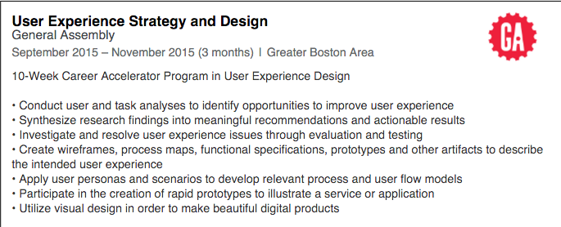
GA - EXPERIENCE
LINKEDIN – the important stuff
Focus on your accomplishments and projects, as you would describe a job
Be sure to use the word “Immersive” somewhere. This looks like a UX Designer who works at GA!

Slide 31
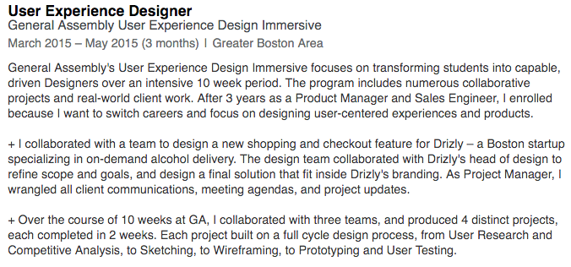
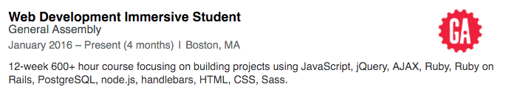
GA – EXPERIENCE EXAMPLES
LINKEDIN – the important stuff
Be clear that this a training program where you created real-world projects.

Slide 32
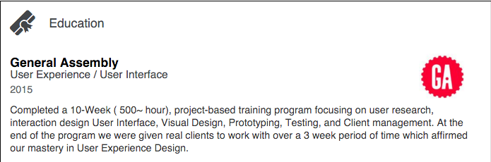
GA - EDUCATION
LINKEDIN – the important stuff
Describe the 12-week program, the certificate you earned, and skills.

Slide 33
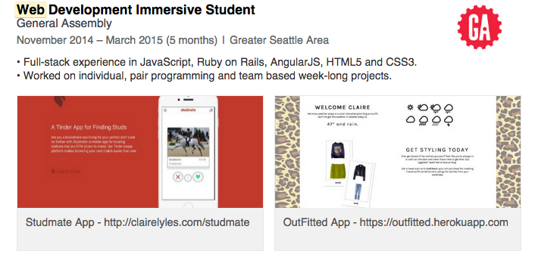
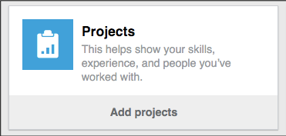
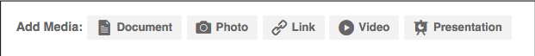
ADD PROJECTS + Media
LINKEDIN – the important stuff
Select “edit” on your profile
Add more sections, such as Projects, Publications, etc.
Look for “Add Media” prompts.
Make sure your portfolio and other websites are easy to find.
Add your GA projects!!!

Slide 34
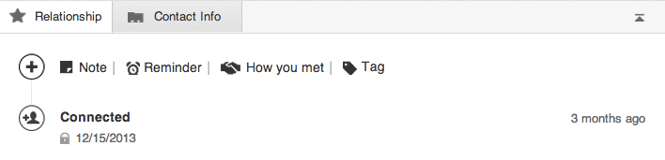
CONNECTING ON LINKEDIN
LINKEDIN EXTRAS
Connect within 24 hours
Send a personalized note (beware on mobile)
Accepting requests from strangers?
How to get to 500+ connections
Keep up with your
network via the “Relationship” tab

Slide 35

DIGITAL PRESENCE & TOOLS
LET’S GET THAT LINKEDIN looking good!

Slide 36
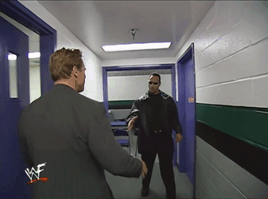
DIGITAL PRESENCE & TOOLS
LET’s Make some Friends!
Browse the General Assembly University Page
Join the GA Alumni LinkedIn Group
Connect with all of your GA colleagues + instructors

Slide 37
PERSONAL BRANDING
ASSIGNMENTS – DUE IN GOOGLE DOC
Update headshot + headline
Include a compelling summary
Fill out Experience + Education sections
Customize URL, adjust privacy settings
Add projects and media
Work toward 500+ connections (ongoing)
Participate in the conversation (ongoing)

Slide 38
Q&A & MORE SLIDES
DIGITAL PRESENCE
Exit ticket: https://ga-research.typeform.com/to/tKqUa1

Slide 39
MORE RESOURCES
LINKEDIN EXTRAS
Visual guide to your complete LinkedIn profile
35 steps to mastering LinkedIn
Leveraging LinkedIn to Change Careers
How to Attract Recruiters to your LinkedIn Profile
Tips for a #WINNING Github Profile

Slide 40
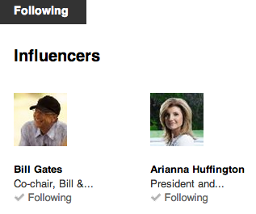
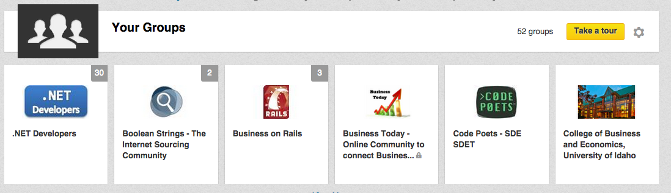
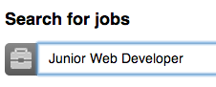
GETTING THE MOST OUT OF LINKEDIN
Digital Presence – the EXTRAS
Join relevant groups (JS devs, UMass grads, etc.)
Follow your favorite companies
Meet strangers and request informational interviews
Use advanced search to find hiring managers
Share, read, and comment on articles
Search for jobs, and see who you know at the company

Slide 41

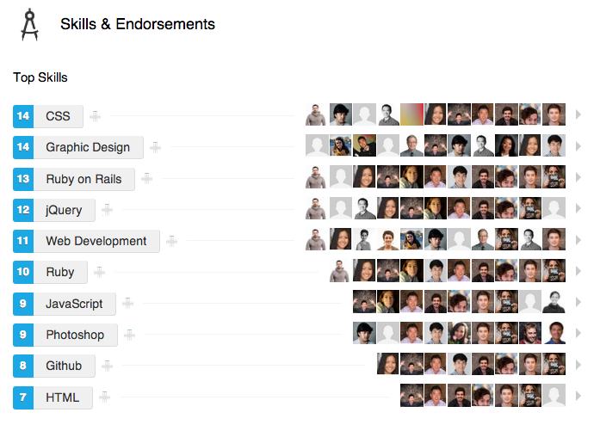
SKILLS + ENDORSEMENTS
LINKEDIN EXTRAS
Make sure you have the skills that are most relevant to your job search at the top
Endorsements are helpful, not critical

Slide 42
Developing your Network

Slide 43
DEVELOPING YOUR NETWORK
DO I HAVE TO?
Five-finger check: How excited are you about networking?
5 = So excited I might pee my pants
1 = So terrified I might pee my pants

Slide 44
Networking advantages and challenges
Developing your Network
Best way to find a job – in the long run
Find a job with a company and people you really like
Job ads draw too many applicants (250 apps average)
Many jobs are filled before advertising (up to 80% never posted)
Challenges
What challenges do you face in networking?

Slide 45
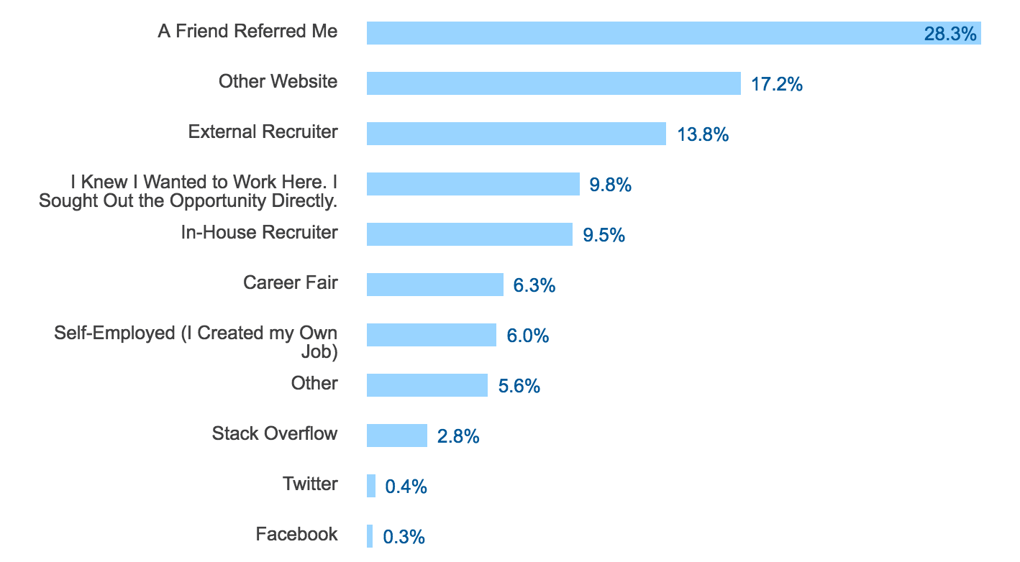
Developing your Network
Source
StackOverflow

Slide 46
DEVELOPING YOUR NETWORK
NETWORKING ADVICE

Slide 47
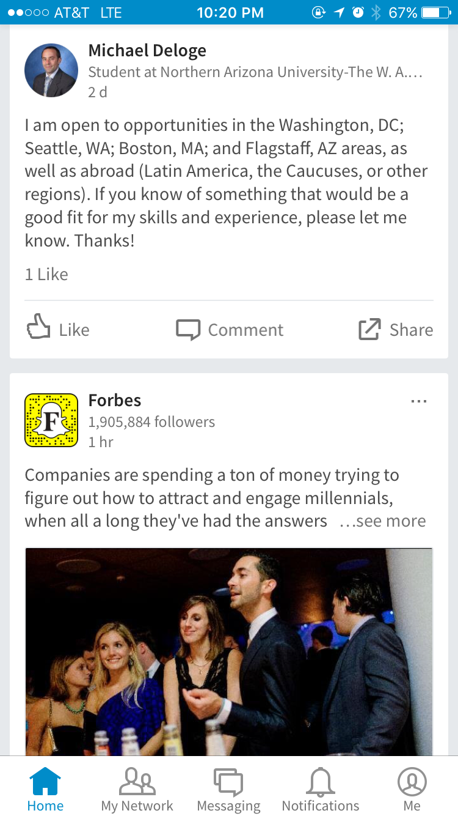
DON’t BE THIS GUY
NETWORKING ADVICE

Slide 48

Building strong relationships
Notes:
FACILITATOR SCRIPT:
Key to any strong relationship is trust. Your professional network is no exception
How to build that trust?
Visibility – get out there. Let people know who you are, what you do. This is where your elevator pitch starts coming in handy. Use points from the pitch; use your USP
Credibility – this takes time. But they need to know what you are good at. Be genuinely good at what interests you and stay in touch.
Profitability – once you establish the trust, your network will want to refer you or hire you
Start by always listening – get to know this person
Find out what their interests are – this could take a few conversations – has to come up organically
But it all starts… with a handshake

Slide 49
Building strong relationships
Developing your Network
Networking is about relationships, not transactions
Strong relationships have mutual value: Both parties see benefit in helping each other
Pair + Share: Talk about a time someone you know helped you advance your career
Notes:
FACILITATOR SCRIPT:
Key to any strong relationship is trust. Your professional network is no exception
How to build that trust?
Visibility – get out there. Let people know who you are, what you do. This is where your elevator pitch starts coming in handy. Use points from the pitch; use your USP
Credibility – this takes time. But they need to know what you are good at. Be genuinely good at what interests you and stay in touch.
Profitability – once you establish the trust, your network will want to refer you or hire you
Start by always listening – get to know this person
Find out what their interests are – this could take a few conversations – has to come up organically

Slide 50

KNOW your landscape
Notes:
FACILITATOR SCRIPT:
You already have a network
Just need to get organized
List which companies you want to work for – startup, large corporations, management consulting, dev shop, etc.
List who you already know (friends)
Use LinkedIn and see if your connections have connections that might be able to help
Once you organize these thoughts, next step is to start getting out there
You should do that now
I will send you a few resources of meetups and other groups that you could start attending
Then, reach out to those you already know
If any 2nd degree connection interests you, ask your 1st degree connection for an introduction

Slide 51
Understand your networking landscape
Developing your Network
Keep a list of companies that you would like to work
Join mailing lists (GA, BostInno, VentureFizz, Greenhorn Connect)
Attend events to get to know people, companies, and Boston trends
Leverage your existing network
Look up your 2nd degree connections
Live in the city where you job-seek
Notes:
FACILITATOR SCRIPT:
You already have a network
Just need to get organized
List which companies you want to work for – startup, large corporations, management consulting, dev shop, etc.
List who you already know (friends)
Use LinkedIn and see if your connections have connections that might be able to help
Once you organize these thoughts, next step is to start getting out there
You should do that now
I will send you a few resources of meetups and other groups that you could start attending
Then, reach out to those you already know
If any 2nd degree connection interests you, ask your 1st degree connection for an introduction

Slide 52

When is it Time to NetworK?
Always. It’s Always Time to Network.
Notes:
FACILITATOR SCRIPT:
Stay in touch
Use every free moment to connect / re-connect with someone
Congratulate them on significant events

Slide 53
Maintaining the network
Developing your Network
It’s always time for networking
Don’t wait until you need something!
Fruit snacks example
Email, call, get coffee/ lunch/ go rock climbing
Check in after a promotion, new job, news article …
8 Steps To Build Relationships After A Networking Event
Notes:
FACILITATOR SCRIPT:
Stay in touch
Use every free moment to connect / re-connect with someone
Congratulate them on significant events

Slide 54

Developing your Network
AND YET…
IT’S NEVER TOO LATE TO GET BACK IN TOUCH.

Slide 55
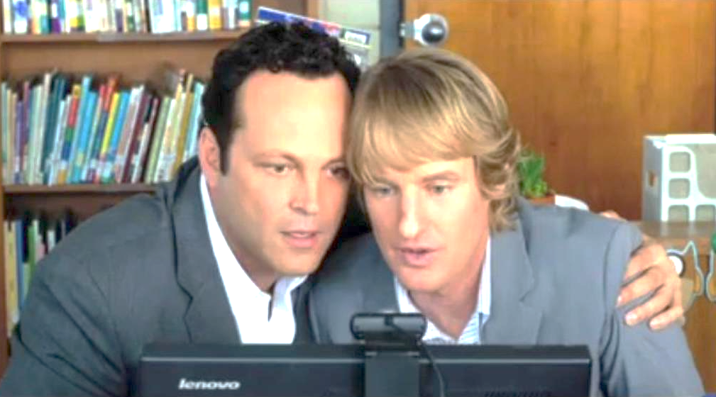
INFORMATIONAL INTERVIEWS

Slide 56
INFORMATIONAL INTERVIEWING
DEVELOPING YOUR NETWORK
A relationship-building strategy, for new or existing relationships
How do you ask for one?
What questions should you ask?
Do NOT ask for a job
Do NOT say, “If you hear of any jobs, please pass along my resume!”
How To Land And Ace An Informational Interview
5 Tips for Non-Awkward Informational Interviews

Slide 57
ACTIVITY:
DEVELOPING YOUR NETWORK
Informational Interview Request

Slide 58

DEVELOPING YOUR NETWORK
Informational INTERVIEW REQUEST
Pick someone you know, or find a new relevant contact.
Draft an email requesting an informational interview.
Get feedback from colleagues and send it!

Slide 59

WERK IT
WERK DAT ROOM
Notes:
FACILITATOR SCRIPT:
You already have a network
Just need to get organized
List which companies you want to work for – startup, large corporations, management consulting, dev shop, etc.
List who you already know (friends)
Use LinkedIn and see if your connections have connections that might be able to help
Once you organize these thoughts, next step is to start getting out there
You should do that now
I will send you a few resources of meetups and other groups that you could start attending
Then, reach out to those you already know
If any 2nd degree connection interests you, ask your 1st degree connection for an introduction

Slide 60
HOW TO WORK A ROOM
Developing your Network
Set goals, such as: “I’m going to meet 4 new people tonight” or “I’m going to introduce myself to the speaker or organizer.”
Bring a friend, and step out of your comfort zone together.
Do NOT ask for a job. Ask for advice.
Know when to GTFO. “I’d love to keep chatting, but I’m sure you want to meet others. Can I get your card and follow up?” Or try the classic drink refill.
48 Questions That'll Make Awkward Small Talk So Much Easier
Notes:
FACILITATOR SCRIPT:
You already have a network
Just need to get organized
List which companies you want to work for – startup, large corporations, management consulting, dev shop, etc.
List who you already know (friends)
Use LinkedIn and see if your connections have connections that might be able to help
Once you organize these thoughts, next step is to start getting out there
You should do that now
I will send you a few resources of meetups and other groups that you could start attending
Then, reach out to those you already know
If any 2nd degree connection interests you, ask your 1st degree connection for an introduction

Slide 61
ACTIVITY:
DEVELOPING YOUR NETWORK
Find an Event to Attend

Slide 62
FIND AN EVENT TO ATTEND
Developing your Network
Event Listings
GA Boston events
Meetup.com groups
VentureFizz, BostInno
Boston TweetUp
Greenhorn Connect
StartHUB newsletter
Share on Slack when you find a great event.
It can be industry-specific, general networking, or skill-building.
Notes:
TIME: 20 minutes (for this section)
FACILITATOR SCRIPT:
Another speaking exercise
I will first go through purpose of an elevator pitch, tips and tricks
Then you will be asked to think of the pitch for two minutes
After two minutes you will go through your pitch. I will ask each of you to give your pitch
I will first give you guidelines, then…
EXERCISE INSTRUCTIONS:
Take 2 min. to think what your pitch would be to your mom, or CTO or a Founder of a company
I will let you know on 1 min. mark
At 2 minutes, I will request you to reconvene
We will start from one side of the room and go serially
Each person will get 20 sec. to tell me and the class about yourself
Start by telling us who your target audience is (mom/ CTO/ Founder, etc.)
This is a follow up to the introductions-exercise, but not the same thing. I will tell you why later

Slide 63
Outcomes Assignments
DEVELOPING YOUR NETWORK

Slide 64
DEVELOPING YOUR NETWORK
OUTCOMES ASSIGNMENT
Find 1 event or meet-up to attend. Event must occur in the next month.
Set up 2 informational interviews (1 person you know, 1 person you don’t). Do outreach this week, schedule meetings for the next month.
Deliverables: put info in Outcomes Google doc.

Slide 65
Q&A & Exit Ticket
DEVELOPING YOUR NETWORK
Exit ticket: https://ga-research.typeform.com/to/tKqUa1

